Slide 1
Explanation of Why Diffusion Waves End
By Michelle Goodman

Slide 2
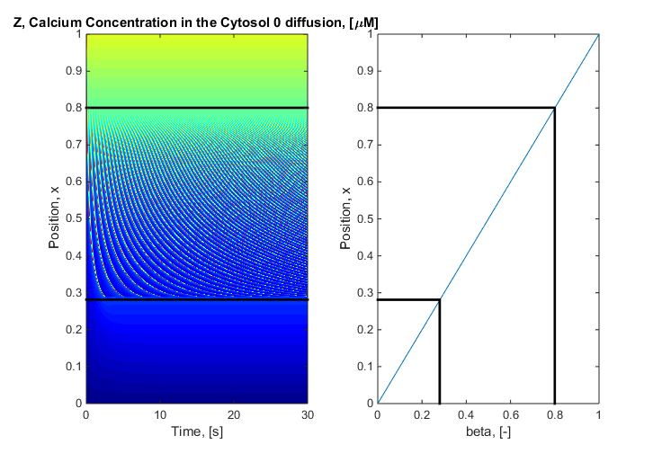
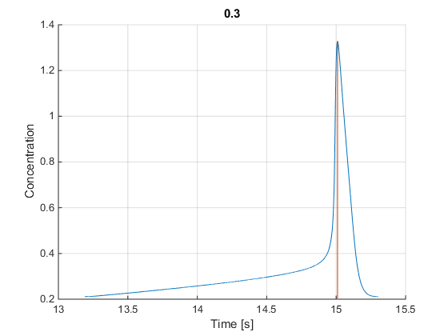
Global vs Position vs Single Wave Profile

Slide 3
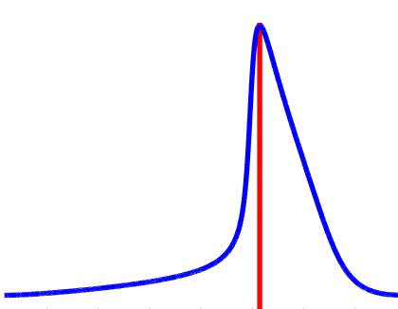
Position Wave Profile for 3 Positions
P_{above}
Note: The wave is front heavy
Rapid Increase
Slow Decrease
To do with the nonlinear terms in the Goldbeter
P₀
P_{below}
Global Wave Profile

Slide 4
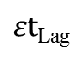
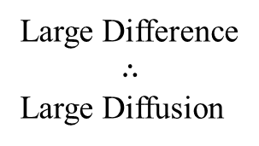
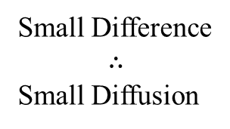
Single Wave Profile for 3 Positions
Diffusion is proportional to
the difference in concentration
between two cells
Small Difference
$$∴$$
Small Diffusion
Large Difference
$$∴$$
Large Diffusion
$εt$_{Lag}
P_{above} P₀ P_{below}

Slide 5
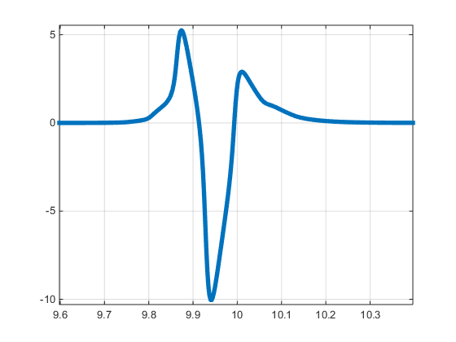
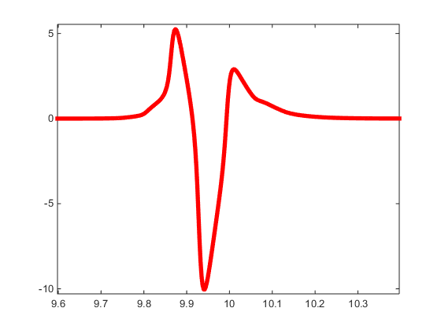
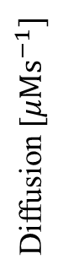
Diffusion Profile As Wave Passes
Diffusion coming in from cell Above
Diffusion coming in from cell Below
Diffusion [$μMs^{−1}]$
Diffusion leaving to cells above and below
Time [s]

Slide 6
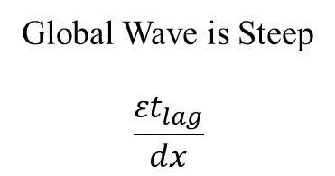
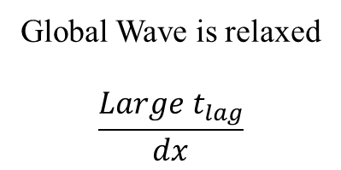
Single Wave Profile for 3 Positions
P₋₁
Global Wave is Steep
$$\frac{{εt}_{lag}}{dx}$$
Global Wave is relaxed
$$\frac{{Large t}_{lag}}{dx}$$
P₀
P₊₁

Slide 7
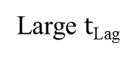
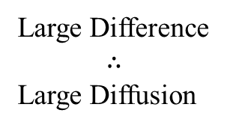
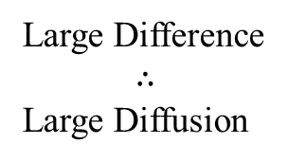
Single Wave Profile for 3 Positions
Diffusion is proportional to
the difference in concentration
between two cells
Large Difference
$$∴$$
Large Diffusion
Large Difference
$$∴$$
Large Diffusion
Large $t$_{Lag}
P_{above} P₀ P_{below}

Slide 8
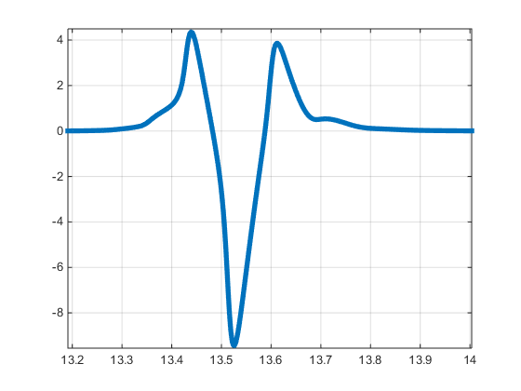
Diffusion Profile As Wave Passes
The amount of diffusion coming in from above
The amount of diffusion coming in from below
=
Diffusion
The Global Wave Stops
Time [s]

Slide 9
Importance of Front Heavy wave
Front heavy means it is not symmetrical
If it was symmetrical the diffusion from the cell above would equal the diffusion from the cell below
Therefore no diffusion
Thus this is why the none of the toy models worked

Slide 10
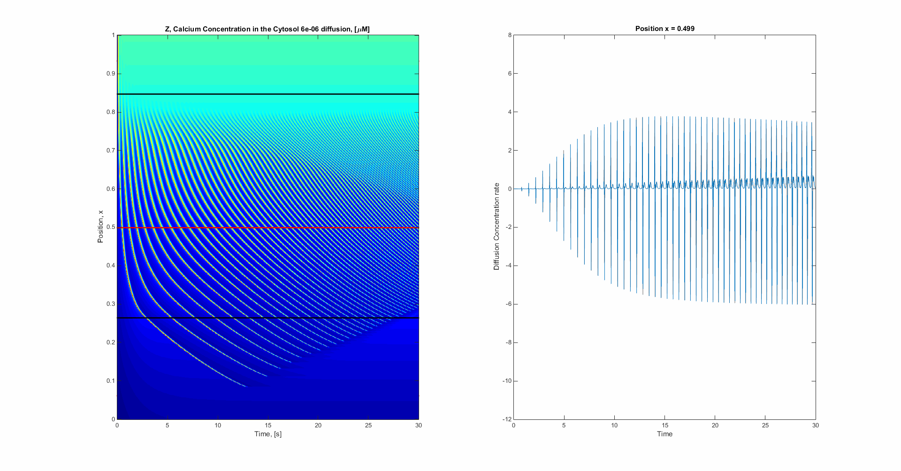

When Diffusion coming in from cell Above = Diffusion coming in from cell Below
Then the Global wave profile stops
As the gradient of the Global profile increases (becomes more relaxed) the Diffusion coming in from the cell below increases
Diffusion coming in from cell Above
Diffusion coming in from cell Below
Diffusion leaving to cells above and below

Slide 11
Summary
For each positon there is an associated:
Beta
Different single wave profile
Gradient of the Global wave profile (some t_{lag})
Such that the wave will stop
Questions:
What is the relationship between beta, the single wave profile and t_{lag} for zero diffusion?
Can we extrapolate this relationship into the region below the bifurcation point? Thus predicting the diffusion case
What is the shape of the Global Wave profile determined by?
Can you determine $β$ from the concentration profile?
How much does diffusion must change the shape of the wave?

